Slide 1
Leasehold Conference 2022
We will be starting at 10:15 am

Slide 2
Welcome
Thank you for joining the Leasehold Conference
We will be starting at 10:15 am

Slide 3
Agenda
Time | Session | Overview
10:30am – 11:00am | Housing Sustainability | Anthony Jones
11:00am – 11:30am | Resident Engagement | Henry Roffey
11.30am – 12:30pm | Citizen Advice | Noreen O'Neil
12:30pm -1:00pm | Residents Voice | Resident of Lupus Street – Pauline Moran
1:00pm- 1:15pm | 15 minute break | 15 minute break
1:15pm - 1:45pm | Cost of living / energy costs | Paul Halpin
1:45pm- 2:45pm | Leasehold Advisory Service | Anthony Essien
2:45pm - 3:15pm | Q&A panel | Ask your questions relevant to you, and they will be answered live by senior officers

Slide 4
Housing Sustainability
Anthony Jones
Head of Housing Sustainability

Slide 5
Update on Housing’s carbon reduction plans for Social Homes.
Anthony Jones
Head of Sustainability for Housing

Slide 6
Housing - Responding to the Climate Emergency
A Pan-London borough supported Action plan
Since 2020 WCC has been working with London Councils to create a peer reviewed action plan to retrofit our Housing stock to an average of an EPC B and to a net Zero Standard.
In Summer 2021 this plan was approved by the London borough Housing Directors. It was forwarded to all Lead Cabinet members in London in September 2021.
WCC action plan is aligned to this pan London plan and utilises the same Full SAP modelling tool which informed the plan.
Development of Implementation plan is now in progress and confident our early initiatives will be part of and supported by this pan London implementation plan
Workshops for implementation plan held and attended during November 2021.
An implementation plan is currently in Draft.
Strategy available on request.

Slide 7
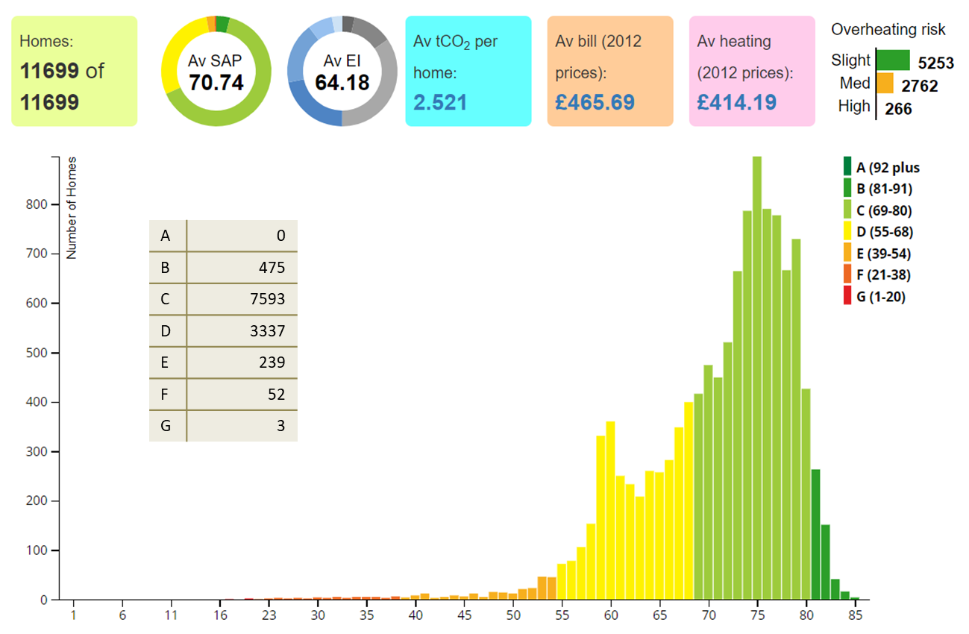
Housing - Responding to the Climate Emergency
Housing Decarbonisation Progress
Benchmarking:
Carbon an SAP modelling tool “Portfolio” implemented.
Multiple Investment scenario models produced and analysed.
Networking and collaboration:
Input into London Councils Retrofit action plan for London. (agreed Sep 2021)
Currently working on an Retrofit implementation plan and part of GLA funded assessment and gap analysis for readiness to get to Net zero.
Attend carbon assessment user groups, sharing best practice and initiatives.
Engagement with planning officers, term contractors, RPs, climate team, GLA, BEIS, Danish Embassy + others.
Financially planning
Estimated programme costs are being modelled in 30 year business plan for WCC social rented homes. From the detailed modelling of Westminster’s social housing portfolio we have estimated that circa £220m of investment is required to achieve an average SAP B rating and then Net Zero.

Slide 8
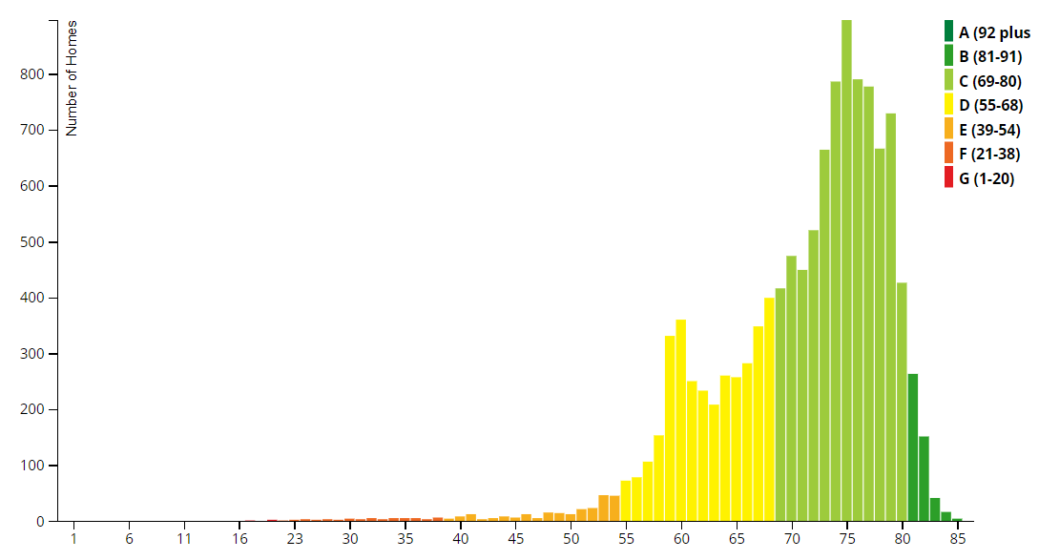
Housing - Responding to the Climate Emergency
Housing Carbon and Energy efficiency modelling results
Heating fuel
Communal Gas | 33%
Individual Gas | 55%
Electric systems | 12%
A | 0
B | 475
C | 7593
D | 3337
E | 239
F | 52
G | 3
PV panels | % of stock | Total System size
Installed on 57 Blocks | 9% | 446 Kwp
Double Glazing | % of stock
 | 61%
Wall Insulation | % of stock
 | 44%
Total carbon produced by WCC managed social rented stock is just under 30,000.
Conservation | % of stock
Listed | 15%
Conservation Area | 44%

Slide 9
Housing - Responding to the Climate Emergency
Housing Decarbonisation Progress
Fabric improvement works are being carried out on appropriate void properties. Works incl secondary glazing, draught proofing, loft, floor & wall insulation and LED lighting
>125 homes E and D rated homes have received retrofit works under Local Authority delivered Green Homes Grants Ph 1 which provided £260k of funding as part of a total spend of £400k.
LAD 2 scheme launched by BEIS ended in Sept 2022 and has benefited a further 106 homes. £561k received as part of a total spend of £780k.
£3.3m + Match funding (Circa £1.7m) SHDF scheme underway – 600 homes assessed, 160+ completions and 100 homes have costs agreed and will be scheduled for install in the next 2 months. 360 will benefit by the end of the year. Circa 350 refusals to date.
SHDF Wave 2 grant funding applications due 18th Nov.
Roofs that are planned for roof renewal are being prioritised for assessment for PV. Previously renewed roofs have been assessed for PV and currently waiting for PV installation proposals from term contractors.
Examples – Warwick Lowrise - Axis. UL investigating Churchill Gardens and Avenue Gardens.

Slide 10
Warwick Estate Solar PV Atherstone Court + others
On site Oct 22 projected to finish in July 2023
One of the largest Social Housing Solar Panel roof top installation in Europe.
306KWHp of Solar panels which has increased our current capacity from 446KWp to 753KWp, an increase of almost 70%!
Many more planned – Avenue Gdns and Churchill Gdns to be investigated + all new roof replacement schemes.
Actual photos and timelapse to come in Dec once first panels arrive (currently completing enabling works such as cabling)

Slide 11
Housing - Responding to the Climate Emergency
Housing Decarbonisation Progress
Project underway/ planned
ECO 4 released. Focus on Private home owners which we would like to support and investigate any options to reduce the cost of windows, roofs and communal heating upgrades.
Circa 50 communal and district heating systems required to have a outline strategy to get to a net zero standard before 2030 by the end of 2023.
WCC wide Local Area Energy Plan to be completed by end of 2023.
Pilot of a net zero assessment being completed on 2 blocks with individual Gas boilers to understand the options to decarbonise the heating to those individual properties before assessments of all blocks.
GLA retrofit capability assessment completed and feedback given to us with 2 other pilot organisations Redbridge and ISHA. Very good feedback.
Development team are building to a min EPC SAP B rating and < 0.25 tCo2 per home.
Energy Saving show home in Bravington Road has been open for 6 months and will be a case study once let out and monitored (letting process to begin late Nov). More details on the next 2 slides.

Slide 12
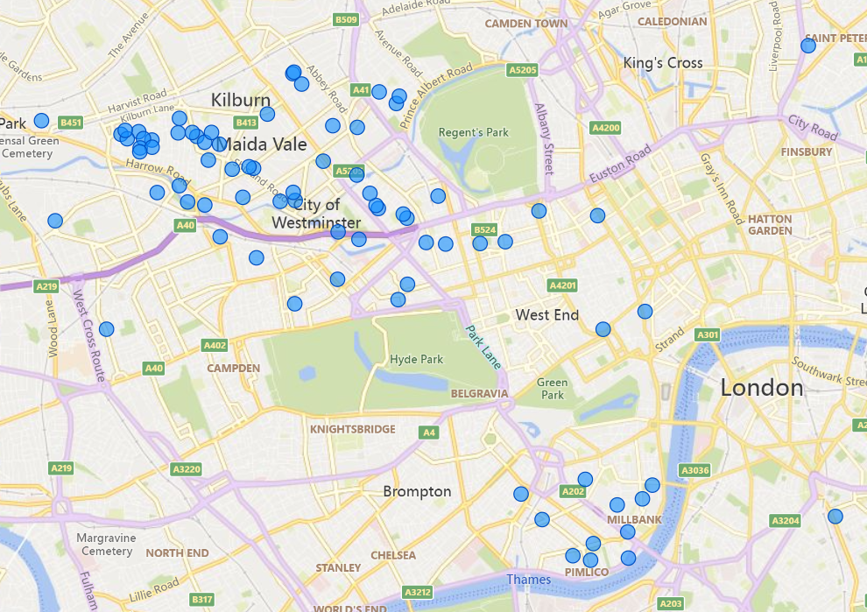
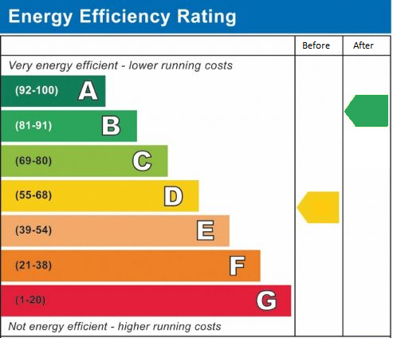
Energy Saving Show Home
Retrofitted one-bedroom void unit
Over 200 visitors
118 on public tours, 20 x 1:1 tours for WCC tenants, 48 WCC staff and 20 from other boroughs.
Public tours well attended by owner occupiers (73%) and residents from the north of the borough:
Energy demand for heating reduced by 55%
EPC rating increased from low D to high B
Expected to be self-sufficient for energy

Slide 13
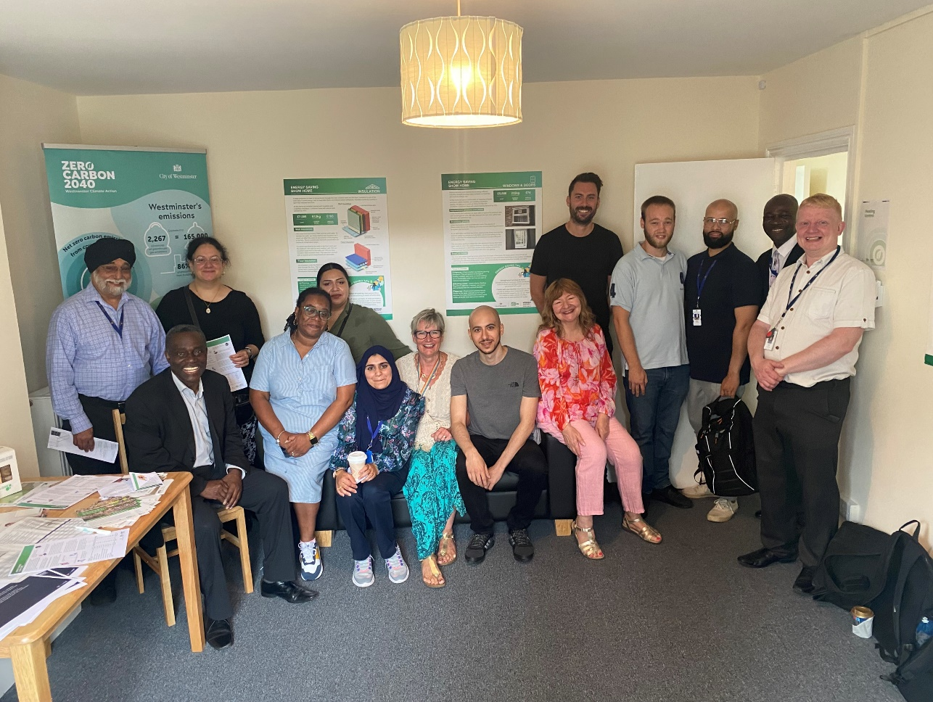
Energy Saving Show Home
Positive feedback and insight
Average 4.5 out of 5 rating
Attendees are now more likely to insulate, undertake window improvements, install solar PV.
High demand for additional advice & support:
Clearer information on planning requirements
Trusted advice (home surveys and bespoke retrofit plans)
Trusted suppliers
Financial support
Next steps:
Tours for other councils, final WCC tenant tours
Legacy: video and PDF case study
Let property and undertake 12 month monitoring
Planning for a future show home in South Westminster
“It was enormously helpful - in 10 minutes I could see and understand the improvements and the technology, which would have taken me several hours of research on the internet.” Susan, Little Venice resident

Slide 14
Leaseholder support for sustainability measures
We are investigating if we can reduce the costs of alterations for sustainability measures.
Following alternation application we would offer use of any block planning permissions or listed Building consent we have for any Estates or blocks.
Planning Guidance: Westminster Environmental planning guidance available on website. Refer to pages 106 to 113 for quick reference guide to what is permitted development and what required planning and/or listed building consent.
Specific window replacement planning guidance competed and further ones planned such as PV & Air Source heat pumps available on website.
Show home was made available to all residents and the next one (planned in south Westminster) will also be advertised and available for tours.
Video of show home and case studies information will be made available on our website and links to PAS 2035 (British retrofit standard)
Links to LAD 3 Green Homes Grants for low income lessees and landlords of low income tenants being run by the GLA and is also called “Sustainable Warmth” and “Warmer Homes “
ECO 4 is primary for private owners and managed by Ofgem.
PV as part of roof renewals to be used to reduce communal energy charges.
Solutions to move away from gas found in our blocks will be shared.

Slide 15
Link to planning guidance to show pages 106 onwards.
https://www.westminster.gov.uk/planning-building-and-environmental-regulations/planning-policy/supplementary-planning-documents-and-guidance/new-supplementary-planning-documents-spd
https://www.westminster.gov.uk/planning-building-and-environmental-regulations/planning-and-climate-emergency-guidance-householders/replacing-or-upgrading-your-windows

Slide 16
Housing - Responding to the Climate Emergency
Challenges and opportunities
Risk/opportunity | Details | Action
Resident take up and leaseholder recharge | Decent homes - take up - circa 75%. Internal wall insulation take up - circa. 20%. | Resident engagement strategy, cost benefit analysis & Grants
Measures not performing as expected | Example is Air source heat pumps – currently no retrofitted heat pumps in stock. | Feasibilities and Pilots
Existing radiators not compatible. | Existing radiators may being compatible with Heat pumps and require replacement. | Feasibilities and Pilots
Measures not being possible/practical or large variance in cost V Budget | It is likely some studies of PV, double & triple glazed windows, particularly in Listed buildings will prove unviable. | Update Modelling and stakeholder engagement
Changes to SAP | Future adjustments will be made to SAP. | Subscribe to relevant organisations and remodel as required
New technology | New technology may be accepted by SAP in the future that is more viable/effective.

Slide 17
Housing - Responding to the Climate Emergency
Challenges and opportunities
Risk/opportunity | Details | Action
Acquisitions | Buying properties with good SAP and/or Net zero potential. | Review of acquisition programmes.
Regeneration | Regeneration could save expenditure and improve carbon reduction if new build standard is high enough. | In hand with development Team
Fuel Bills increasing | Electrically heated properties have the potential to have higher running costs if not used effectively. | Resident engagement, Training, monitoring devices.
Very diverse number of archetypes | WCC use almost 400 beacons to value our housing stock, this gives an idea of the amount of studies and pilots that could be necessary | Consultant support

Slide 18
Housing - Responding to the Climate Emergency
Selection of our Future plans
Risk/opportunity | Details
Complete recruitment | Finish recruitment of team.
SHDF wave 2 funding | SHDF wave 2 funding has just opened for bids and WCC bid is in draft.
Estate wide Heritage plans | Work with English heritage to agree retrofit works for listed buildings
PDHU decarbonisation and investment | SOC to be presented to CRG in Dec/Jan.
Continue work with other Councils and share learning | London Councils, BEIS, working groups, user groups, show homes.
Review every new major works programme for retrofit works | Sustainability sign off required at Client brief stage and programme Board approval.
Create a resident working group to shape Retrofit deliverer | Would like to set up a focus group of residents to evolve our approach to retrofit and net zero.
Consultant support with renewable heating feasibilities | Over 400 distinct archetypes that may require different renewable heating assessments.
PV panels assessed for installation. | 30 Blocks have had roofs replaced in last 5 years and suitable for PV installation. Roofs planned for replacement are being assessed for PV potential before works begin.

Slide 19
Resident Engagement
Henry Roffey
Resident Engagement Manager

Slide 20
No tick box exercises You want to have a real influence over how and what we do. You want us to hear what you have to say and you want us to report back to you. A range of options for engaging and communication Not a one size fits all approach. We should be open, honest, accessible and accountable If we aren't able to do something, we should tell you. If things change, we should tell you why.
What we hear from WCC Residents

Slide 21
Resident Group Briefings
Resident group support, grants and governance
Community events
Consulting on policy reviews
City Wide Engagement
Resident led community projects
New tech to reach wider audiences
Offering options and choices
Supporting Young people and sports
Helping residents to influence major works
Testing new IT systems
Ensuring engagement is representative
Community Thursdays
Working with our Key Lessees

Slide 22
Community Thursdays ​ ​ 18 Community Thursdays​ ​
65 estates visited across 17 wards​ ​
178 different members of staff have taken part​ ​
12 different councillors have joined us​ ​
Over 5000 doors knocked​ ​
2 homeless schemes visited

Slide 23
Resident Advocacy Service
The Advocacy Service is made up of two teams. In total 10 Resident Advocates including one Youth Advocate.
The Resident Engagement & Advocacy Service Manager is Sarah McCarthy.
Sarah McCarthy
over 20 years experience in engagement and communications, in sectors including regeneration, EU politics and higher education. She wants to make sure the service fits the user and not the other way around!

Slide 24
Role of the Resident Advocate
Managing Major Works project resident consultation events in person and online.
Managing Major Works project communications with residents ensuring that all communications are clear, accessible and of a high standard
Supporting residents throughout a Major Works project from initial communications with residents through to completion of works. Providing real opportunities for residents to influence what happens to their homes.
Working closely with our two Major Works Contractors, United Living and Axis.
Ensure that every effort is made to ensure we hear from a broad range of residents, including tenure, age and race.
Working closely with our internal Major Works team, Leasehold Services and the Housing Management teams.
Supporting Social Value Projects

Slide 25
Role of the Youth Advocate
Supporting access to opportunities for young people on our estates.
Working with youth clubs, sports providers, Children’s Services, Youth Offending, the Integrated Gangs and Exploitation Unit, and colleagues from across the Council and voluntary sector to maximise access to good opportunities for young people and to support those at risk of harm or engagement in crime/ASB to access appropriate support.
Seek the views of young people living in our housing stock on issues that affect them and encourage they to become involved in the way that we provide services.
Support Social Value projects that will benefit Young People on our estates.

Slide 26
Encouraging engagement & a youth voice
Young people don’t generally want to be involved in RA’s!
Finding different ways to best engage
Informal drops-ins and regular engagement at several youth clubs
Finding relevant local issues to engage smaller core groups, e.g. on Churchill
Survey on Lisson Green and with Fourth Feathers
Helping Hands Community Network in Queens Park area
Linking with other youth engagement such as youth ambassadors, youth voice & Youth Council

Slide 27
Proposals for city-wide engagement
We used to support four housing service area based resident panels as well as a city wide group.
Instead based on feedback and a review of best practice we proposed creating a more flexible, inclusive and targeted approach by:
Having one city-wide resident panel that comments on policy and performance and helps identify priorities
Creating time limited working groups with residents and officers discussing topics of shared interest
Offering a range of engagement options so every resident can choose an approach that works for them
Making continued use of technology alongside face to face meetings to include more residents

Slide 28
Consultation response
Central 33%
North 13%
South 35%
West 19%
1,677 responses in total
765 online responses
912 responses by post
Notes:
The profile of respondents was similar to data we hold in tenants when broken down by age, ethnicity, disability, gender and tenure.

Slide 29
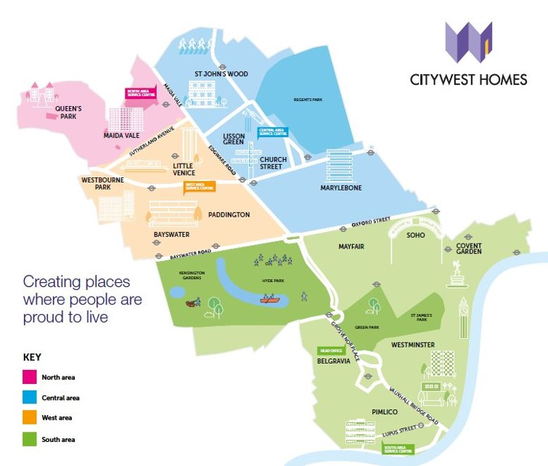
Creating a resident conference
Notes:
What would the best approach be to a resident conference?

Slide 30
Any questions?

Slide 31
Citizen Advice
Noreen O'Neil
Advice Partnership Supervisor

Slide 32
Citizens Advice Westminster Outreach and advice shop update

Slide 33
Our outreach objectives 2022/23
Deliver the Advice Shop service in or around areas of multiple deprivation
Organise outreach activities over the year providing information and support services enabling digitally excluded residents to access advice digitally
Notes:
Our outreach objectives this year are to deliver the Advice Shop service in or around areas of multiple deprivation and, organise 12 outreach activities over the year providing information and support services enabling digitally excluded residents to access advice digitally.
Examples of recent activities – Churchill Gardens Community Festival and Westbourne Park Family Centre.

Slide 34
Index of Multiple Deprivation
Notes:
The index of multiple deprivation identifies the following areas in Westminster to be of greatest deprivation:
Churchill Gardens/Tachbrook
Queens Park
St James
Harrow Road/Westbourne
Church Street

Slide 35
All outreach locations

Slide 36
Partners:
Housing Repairs
Local Cllrs

Slide 37
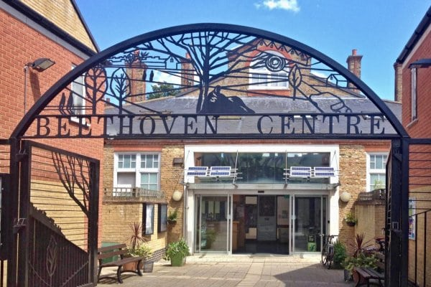
Beethoven Centre
First and Third Monday of the month
Available services:
Citizens Advice
Local Councillor
Shelter
Z2K
The Passage
Age UK Westminster
Carers Network
WCC Repairs
Westminster Employment Service
Energy Champions
2pm to 4:30pm
Notes:
(Queens Park) The Advice Shop continues at The Beethoven Centre
First and Third Monday of the month 2pm to 4pm (this is a pre booked service)
Services available for booking:
Citizens Advice Westminster
Shelter
Z2K
The Passage
Carers Network
Queens Park Local Cllr team
Asylum Aid
BESN

Slide 38
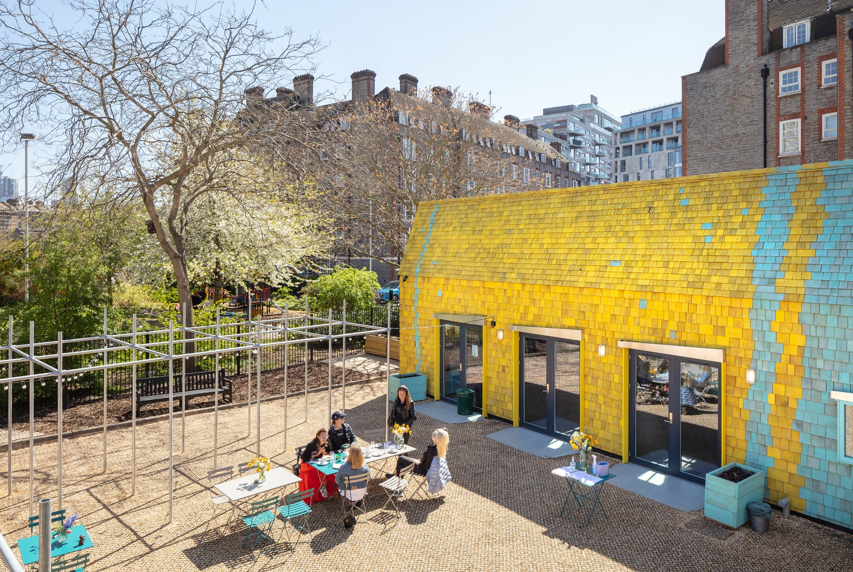
Ebury Edge Community Hall
Every second Tuesday of the month
Available services:
Citizens Advice
Local Councillor
Shelter
Z2K
The Passage
Age UK Westminster
Carers Network
10am to 12pm
Notes:
With this, the current and future plans of the Advice Shop service are:
(Churchill/Tachbrook) The Advice Shop has a new venue in the south of the borough – Ebury Edge Community Hall which replaced Churchill Gardens Residents Hall from 8th March 2022
When? On the second Tuesday of the month at 10am to 12pm (this is a pre booked service)
Services available for booking:
Citizens Advice Westminster
Shelter
Z2K
The Passage
Carers Network
Cllr Liza Begum
AGE UK Westminster – from May 2022

Slide 39
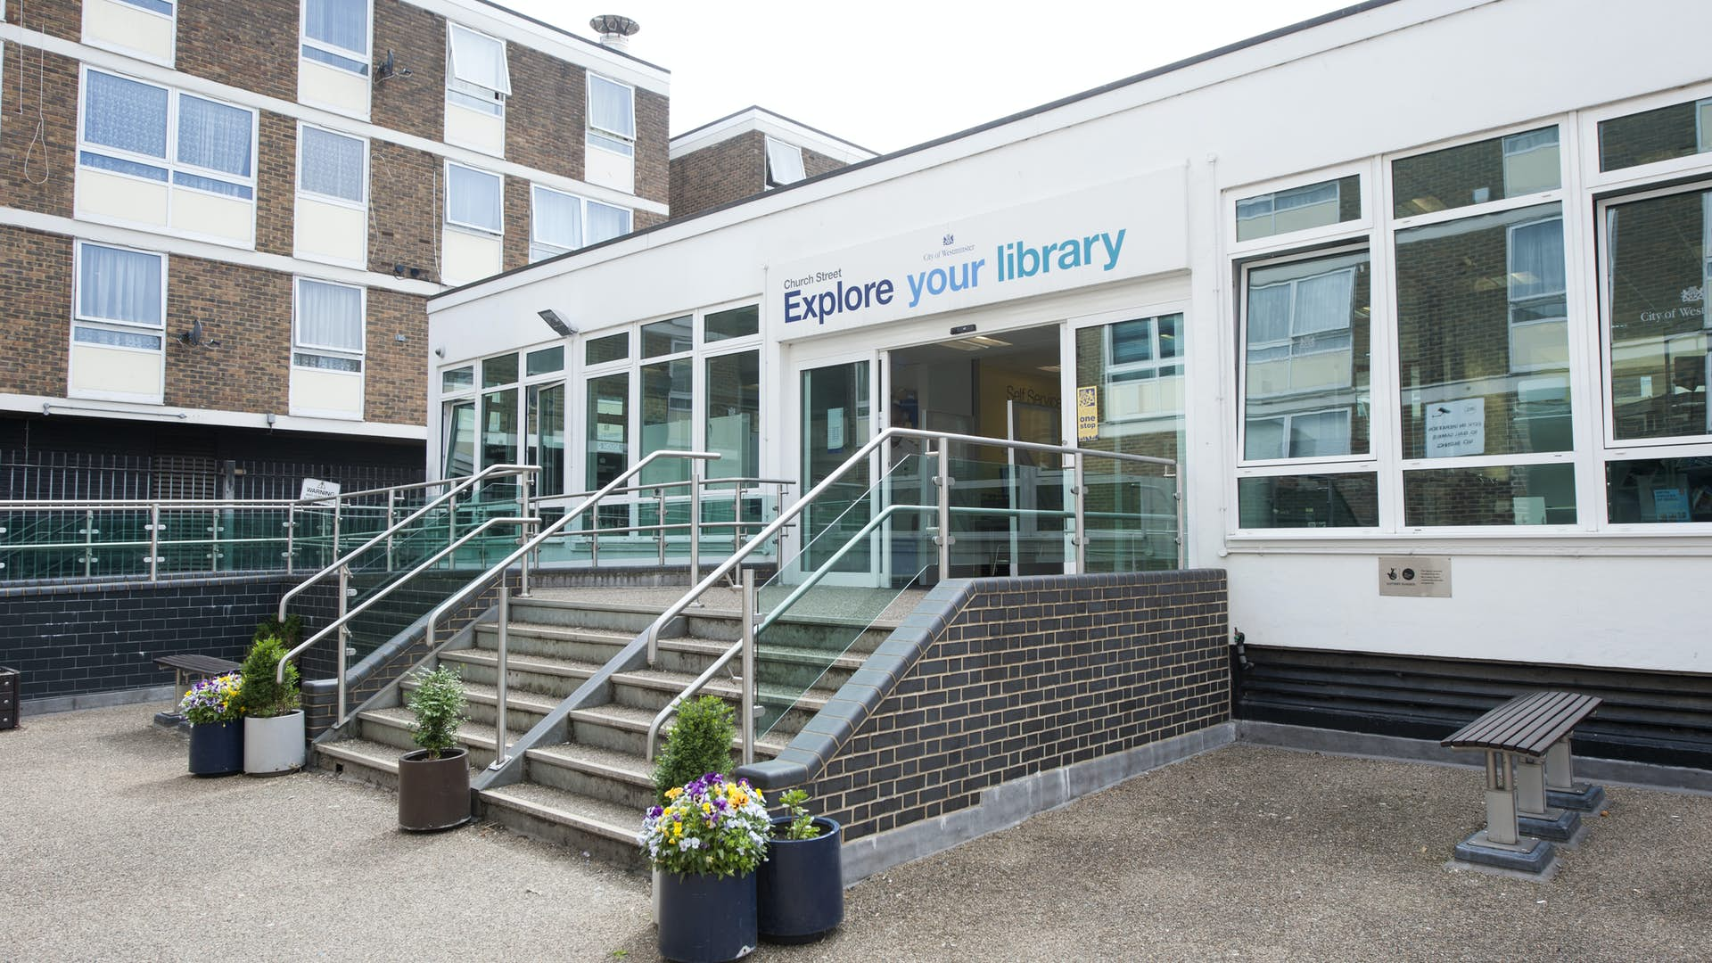
Church Street Library
First and Fourth Wednesday of the month
Available services:
Citizens Advice
Local Councillor
Shelter
Z2K
Carers Network
WCC Repairs
Westminster Employment Service
10:30am to 1pm

Slide 40
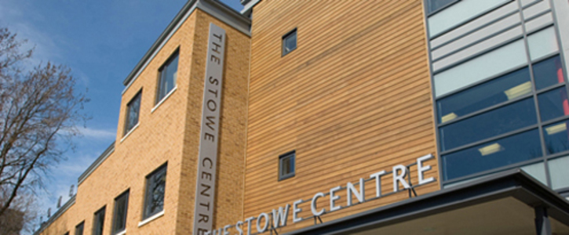
Stowe Centre
Every Second Thursday of the month
Available services:
Citizens Advice
Shelter
The Passage
Carers Network
WCC Repairs
Energy Champions
9:30am to 12pm
Notes:
(St James) We are currently exploring opportunities to extend the Advice Shop service in/around the St James area with two potential venues that we have viewed so far:
The Abbey Centre (Parker Morris Hall on the first floor with elevator access, a slightly smaller hall in the basement with elevator access or within the cafeteria alongside the The Abbey Pantry)
Westminster Chapel (a room may be available adjacent to the Westminster Chapel Food Bank)

Slide 41
Advice shop achievements (since 2021)
50+
Outreach Sessions
400+
clients seen

Slide 42
We are introducing Refernet – a platform for interagency referrals
GDPR compliant and simple to use
Better client journey
Option for self-referral
Client journey traced, ensuring full auditing capabilities
westminster.refernet.co.uk

Slide 43
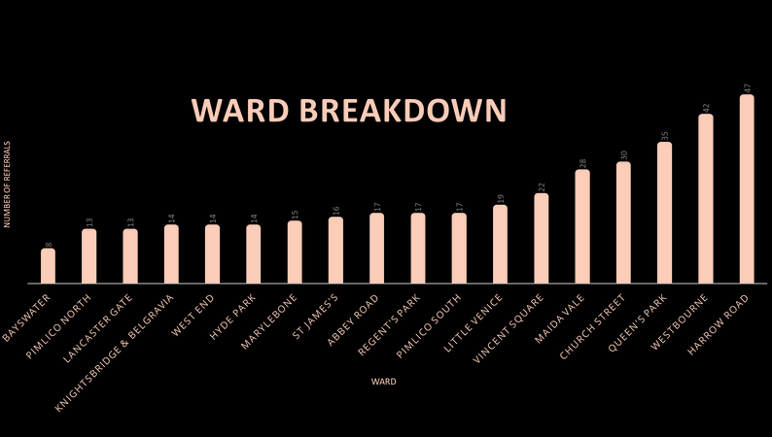
Agency joins partnership
by emailing refernetadmin@westminstercab.org.uk
Agency sign up form is completed and returned. Details are submitted to Refernet
Agency is ready to accept or create referrals
Client information passed seamlessly between referral agencies
Contact is made with the client; outcomes are traced creating a fully auditable record
377
referrals over the period
*406 including Local Hardship Fund
87%
referrals accepted and progressed
(0.2% currently being processed)
Partners
Notting Hill Genesis
One Westminster
Passage Resource Centre
Queens Park Children's Centre
Shelter
St. Vincent's Family Project
Westminster Employment Service HELP Project
SHP Westminster Floating Support
Westminster City Council Private Sector Housing
Age UK Westminster
Asylum Aid
Cardinal Hume Centre
Carers Network
Citizens Advice Westminster
Family Lives Westminster
Karen Buck MP’s Office
Marylebone Bangladesh Society
North Paddington Foodbank
01 December 2021 – 30 September 2022
CLIENT WARD BREAKDOWN
@westminstercab
@westminstercab
Citizens Advice Westminster is the operating name of
Westminster Citizens Advice Bureau Service
Charity Registration Number: 1059419.
Registered Office: The Stowe Centre, 258 Harrow Road,
London W2 5ES

Slide 44
Pro bono legal advice service
Following cuts to civil legal aid, we currently have solicitors providing much needed free legal advice in the below areas of law:
Family Law
Housing Law
Immigration Law
Employment Law
Community Care
Notes:
We are always looking to expand our pro bono services to our clients, so we are working closely with sources to secure more pro bono solicitor services

Slide 45
Remote Services
Our LIVE webchat service
4pm to 6pm
Monday, Tuesday and Wednesday
Our free helpline
0808 278 7834
Mon-Fri 10am-4pm
westminstercab.org.uk
Out of hours contact form
6pm to 10pm
Monday to Friday westminstercab.org.uk/online-enquiry-form
Zoom sessions
Monday and Wednesday
10am to 11am
westminstercab.org.uk/advice/drop-in-session
Fast-track energy advice and information
Monday, Tuesday and Wednesday
10am to 11am
westminstercab.org.uk/advice/lets-talk-money-project/energy-advice-project
Notes:
As part of our accessibility drive, clients can reach us through a variety of different means:

Slide 46
Crisis Prevention Advice Project
With the cost of living rising, this project aims to help clients maximise their income. If they feel like they’re in crisis, or they might be in one soon, our adviser is here to help.
Our adviser provides assistance in:
claiming benefits clients may not know they’re entitled to
housing related issues (eviction, arrears )
money saving tips
budget planning
priority and nonpriority debt
dealing with bailiffs
emergencies such as court action
your goals for dealing with debt
Adviser available at several locations including:
WECH community centre
St Vincent’s family project
The Abbey Centre
westminstercab.org.uk/advice/crisis-prevention-project

Slide 47
Energy Advice Project
Citizens Advice Westminster are now offering specialist energy advice to Westminster residents as part of the Big Energy Saving Network.
We offer energy saving workshops and one-to-one appointments, with our adviser also present at our certain advice shop locations.
westminstercab.org.uk/advice/lets-talk-money-project/energy-advice-project/

Slide 48
North Paddington Foodbank
Clients living in the North Westminster area (Harrow Road, Queens Park, Church St, Little Venice, Maida Vale and Lancaster Gate) that need money advice and help, can drop-in at the North Paddington Foodbank to see our adviser.

Slide 49
Thank you, questions?
@westminstercab
@westminstercab
Citizens Advice Westminster is the operating name of Westminster Citizens Advice Bureau Service
Charity Registration Number: 1059419.
Registered Office: The Stowe Centre, 258 Harrow Road, London W2 5ES
Authorised and regulated by the Financial Conduct Authority: FRN 617795

Slide 50
Residents Voice
Pauline Moran
Resident of Lupus Street

Slide 51
15 minute break
We will be back at 13:15pm

Slide 52
Cost of living / energy costs
Paul Halpin
Head of Leasehold, Income and Resident Engagement
phalpin@westminster.gov.uk
12th November 2022

Slide 53
Cost of living support hub
https://www.westminster.gov.uk/cost-of-living-support
Our approach to tackling the rising cost of living is based on three pillars:
Targeting an initial £8m package of support to help households in Westminster that are struggling with the rising cost of living.
Working with our partners to ensure that we coordinate and maximise our impact.
Making sure our residents have the information they need to access all the support that is on offer to them.

Slide 54
Cost of living support hub
To fulfil this, we are carrying out an eight-point plan and taking action across these key areas to support residents with the cost of living crisis:
1. We’re targeting an initial £8m package of support to help Westminster households that are struggling with rising costs
2. We are helping our residents find ways to manage their bills
3. We are providing ways for residents to switch to lower energy taris and keep food on the table
4. We are exploring energy efficient homes for our residents, which encourage greener lifestyles and lower their bills
5. We are making sure everyone gets the benefits they are entitled to receive
6. We are helping residents understand their financial situation and cope with the pressures of being in debt
7. We are supporting the most vulnerable members of our society cope with changing situations
8. We are maximising the impact we’re having by coordinating our efforts with our partners
Notes:
Key partners we are collaborating with include: Citizens Advice Westminster
North Paddington Foodbank
Westminster Chapel Foodbank
One Westminster
Westbourne Community Pantry
The Abbey Community Pantry
Age UK
Westminster Advice Service Partnership including Asylum Aid

Slide 55
Cost of living support hub
Energy costs - https://www.westminster.gov.uk/cost-of-living-support#energy
Financial help - https://www.westminster.gov.uk/cost-of-living-support#finances
Food support services - https://www.westminster.gov.uk/cost-of-living-support#food
Coping with debt - https://www.westminster.gov.uk/cost-of-living-support#debt
Finding a career - https://www.westminster.gov.uk/cost-of-living-support#career
Mental health support - https://www.westminster.gov.uk/cost-of-living-support#mental-health
Support for organisations - https://www.westminster.gov.uk/cost-of-living-support#organisations
Notes:
Energy costs – Energy price cap / ways to lower energy bills / energy saving trust / smart meters / government rules utility companies must work out payment plans – give you more time - THAMES WATER – low income families
Financial help – Local support Payments / School uniform support scheme / digital inclusion / cost of living digital support package
Food support services – List of food support services open Monday to Saturday around the City
Coping with debt – Interactive money worries form / London Credit Union / Citizens Advice Westminster / Which benefits or grants you are entitled to / StepChange – the UK’s leading debt charity
Finding a career – Westminster Employment Services – Job vacancies in your area web page
Mental health support - Mind Matters / NHS / Westminster Talking Therapies / Links of organisations who can provide comforting pressure environments to listen to your concerns and offer advice
Support for organisations – The healthy winter grants scheme (apply for the grant) and The Community Alliance – Open online forum for all those organisations involved in and interested in supporting people affected by COL

Slide 56
Service Charge Assistance
Please speak to us – we are here to help
Payment plans for day to day service charge
Westminster’s major works payment plans
Hardship fund
www.westminster.gov.uk/housing/leaseholders/service-charges/paying-your-service-charge-video
www.westminster.gov.uk/housing/leaseholders/service-charges/service-charge-support
www.westminster.gov.uk/housing/leaseholders/service-charges/about-your-service-charge
Notes:
Service Charge Support
Westminster Citizen’s Advice - Citizens Advice Westminster offer free, confidential, and impartial information and advice on benefits, debt, money, housing and other issues. They offer a drop-in video advice service for Westminster residents.

Slide 57
Service Charge Assistance
• Tel: 0800 358 3783 (if calling from abroad please dial +44207245 2990)
• Email: housing.enquiries@westminster.gov.uk
• Visit us or by Post: Leasehold Operations, 137 Lupus Street, London, SW1V 3HE
• Book a 20 minute online appointment
Every Monday, Tuesday, Thursday and Friday 9am to 5pm - Every Wednesday 9am to 8pm
www.westminster.gov.uk/housing/leaseholderbooking

Slide 58
Rising energy costs
PDHU and future energy costs
Heating and Hot water charges are billed 1 year in arrears
Westminster City Council can achieve economies of scale by bulk buying
In late 2021 we agreed a rate of 6.2p kWh for gas consumption for a fixed period April 22 – March 23
This new charge will be reflected in your charges in March 2023
The current mid point market capped rate is 10.33p per kWh

Slide 59
helpforhouseholds.campaign.gov.uk
Support with household costs
Help with energy bills
Help with childcare costs
Income support
Help with transport costs
Help finding work

Slide 60
Cost of Living Web Links
https://www.westminster.gov.uk/cost-of-living-support
https://www.westminstercab.org.uk/
https://helpforhouseholds.campaign.gov.uk/
https://www.gov.uk/cost-of-living

Slide 61
Paul Halpin – phalpin@westminster.gov.uk

Slide 62
Leasehold Advisory Service
Anthony Essien
Chief Executive

Slide 63
Leasehold Advisory Service (LEASE)
Presentation to
Westminster City Council Leaseholders Conference 2022
by Anthony Essien, Chief Executive

Slide 64
Agenda
Brief history
Mission
Services
Top 10 enquiry subjects from leaseholders in Westminster – 2021/22 vs 2020/21 vs 2019/20
Reform
Q&A

Slide 65
Brief history
1994: ‘Leasehold Enfranchisement Advisory Service’.
1996: ‘Leasehold Advisory Service (LEASE)’.
2005: LEASE becomes a public body.
2013: LEASE service extended to Park Home owners.
2017: LEASE service for leaseholders in buildings with unsafe cladding.

Slide 66
Mission
“To provide the information, advice and support that leaseholders and park home owners need to resolve their issues and to secure good outcomes wherever possible when in dispute with third parties.”

Slide 67
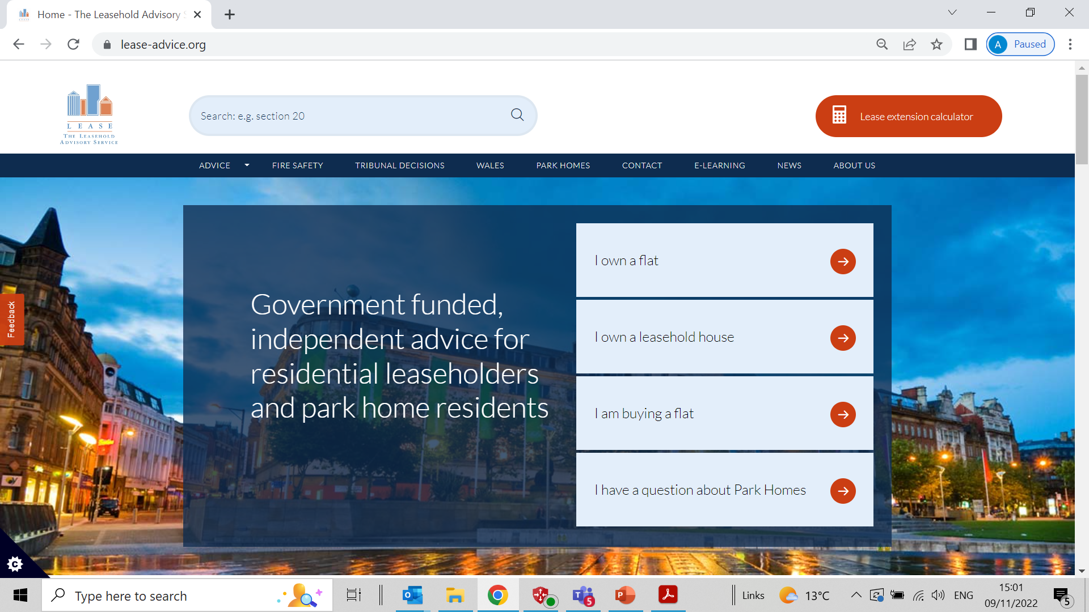

Slide 68
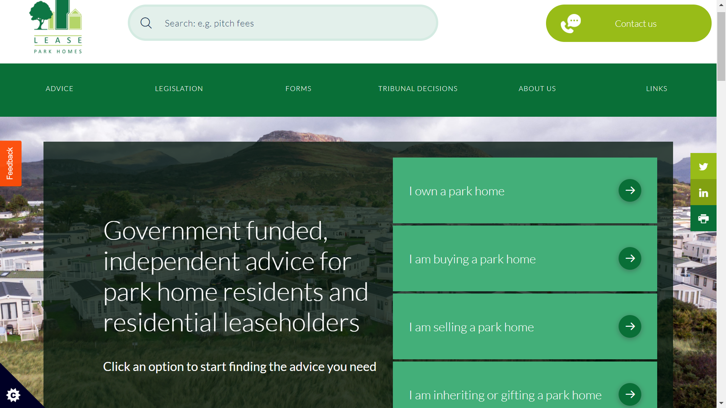

Slide 69
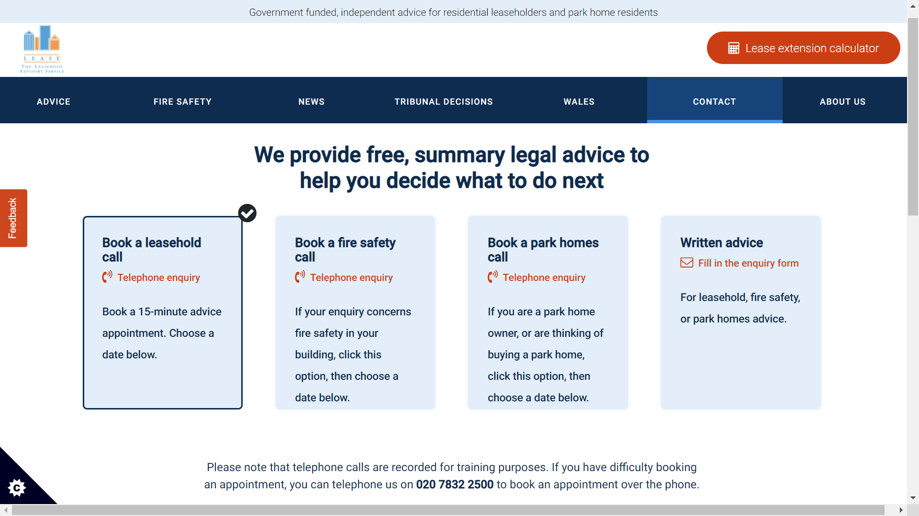

Slide 70
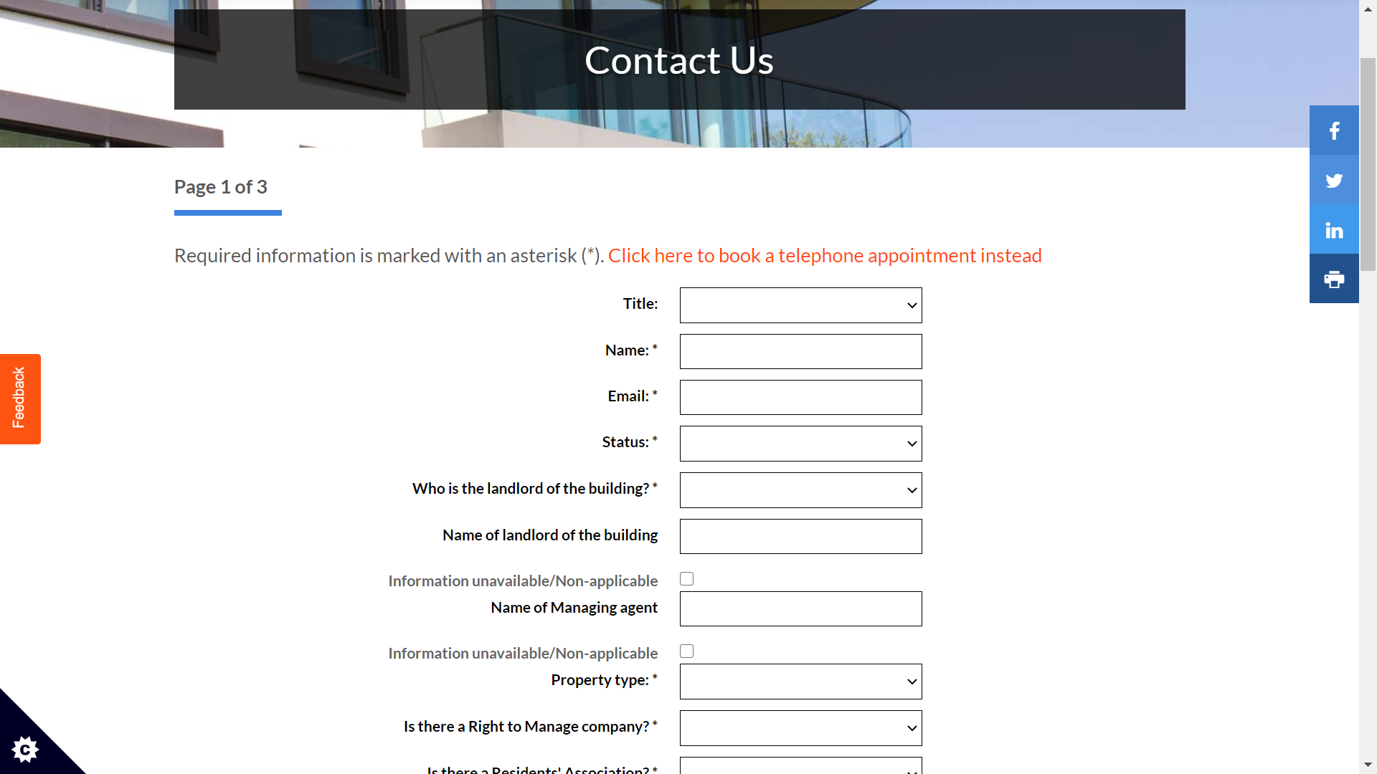

Slide 71
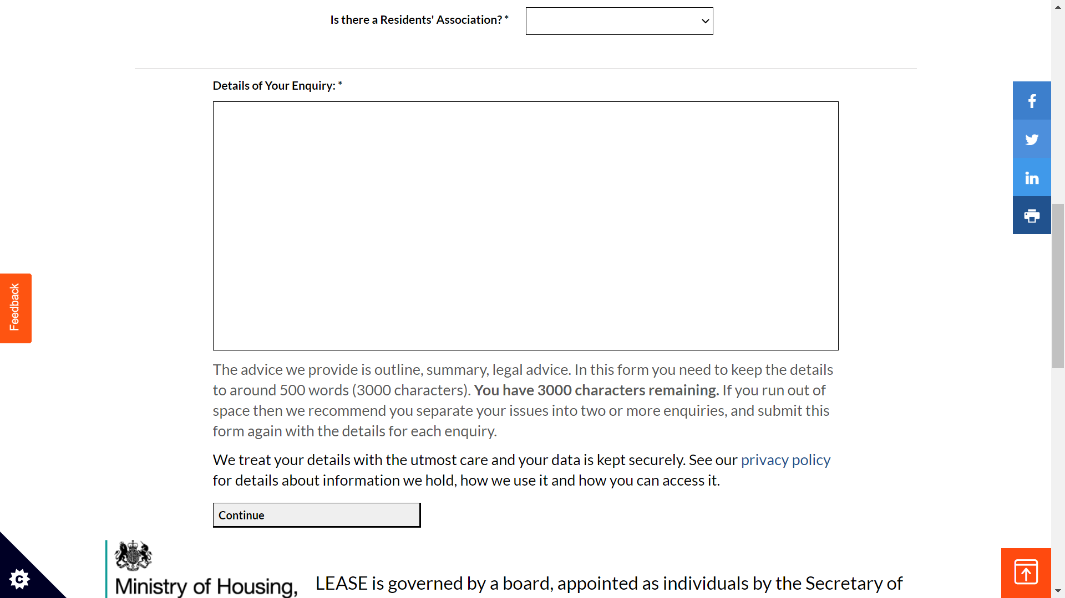

Slide 72
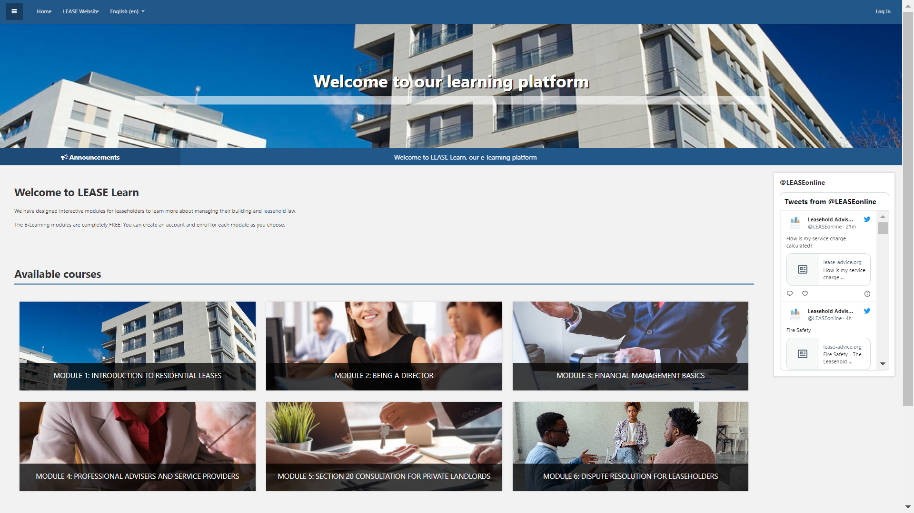
LEASE Learn

Slide 73
Top 10 enquiry subjects from leaseholders in Westminster – 2021/22 vs 2020/21 vs 2019/20

Slide 74
Reform
Leasehold
The Leasehold Reform (Ground Rent) Act 2022 – generally, future ground rents can only be a peppercorn
Future legislation – to make it easier and cheaper for leaseholders to buy their homes
Building Safety
Building Safety Act 2022
Leaseholder Protections
Extension of developers’ liability under the Defective Premises Act 1972
Establishes Building Safety Regulator
Establishes New Homes Ombudsman

Slide 75
Questions?
The Leasehold Advisory Service
020 7832 2500
info@lease-advice.org
www.lease-advice.org
2 Marsham Street, London SW1P 4DP
Working remotely

Slide 76
Q&A

Slide 77
0800 358 3783 housing.enquiries@westminster.gov.uk www.westminster.gov.uk

