Slide 1
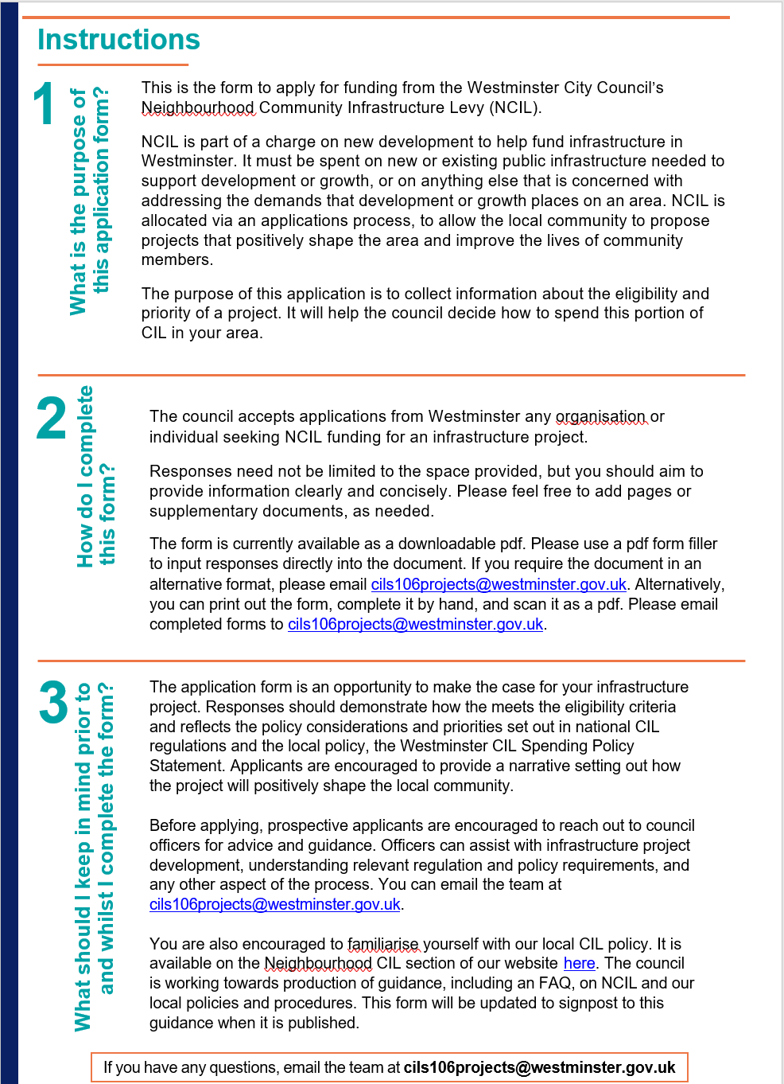
Instructions
Read the instructions page carefully before filling out your application
This will help you understand what information should go where
Speeds up the validation process and ensures your application is assessed and judged fairly

Slide 2
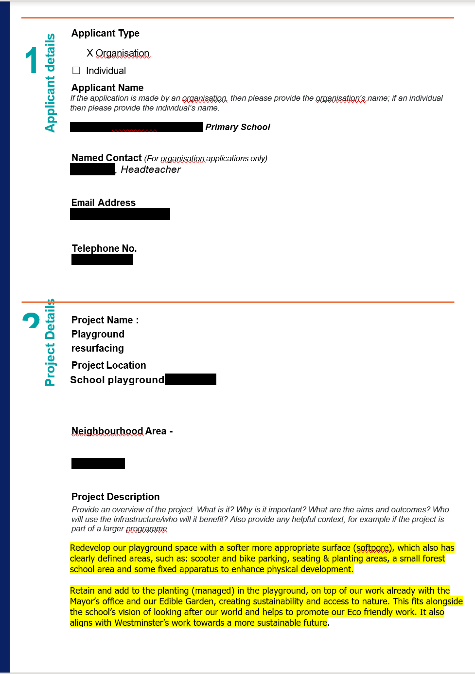
Applicant has identified the difference between the named contact and the applicant: an applicant is who the funding will go to, and the named contact is anyone from inside or outside of that organisation who will submit and receive correspondence on their behalf
Project descriptions should be a summary of exactly what the project is and what aspect of its CIL will fund.
Accurate, concise project name
Describing the project accurately and concisely means there will be no confusion over what CIL is funding, the viability, the value or how it relates to community infrastructure
The applicant provided the neighbourhood area which is what we need. This is often confused with ward area. This demonstrates that they've engaged with their relevant Neighbourhood forum and the council before submitting the application
Accurate, concise description of the works that are going to be carried out, which NCIL funding will pay for

Slide 3
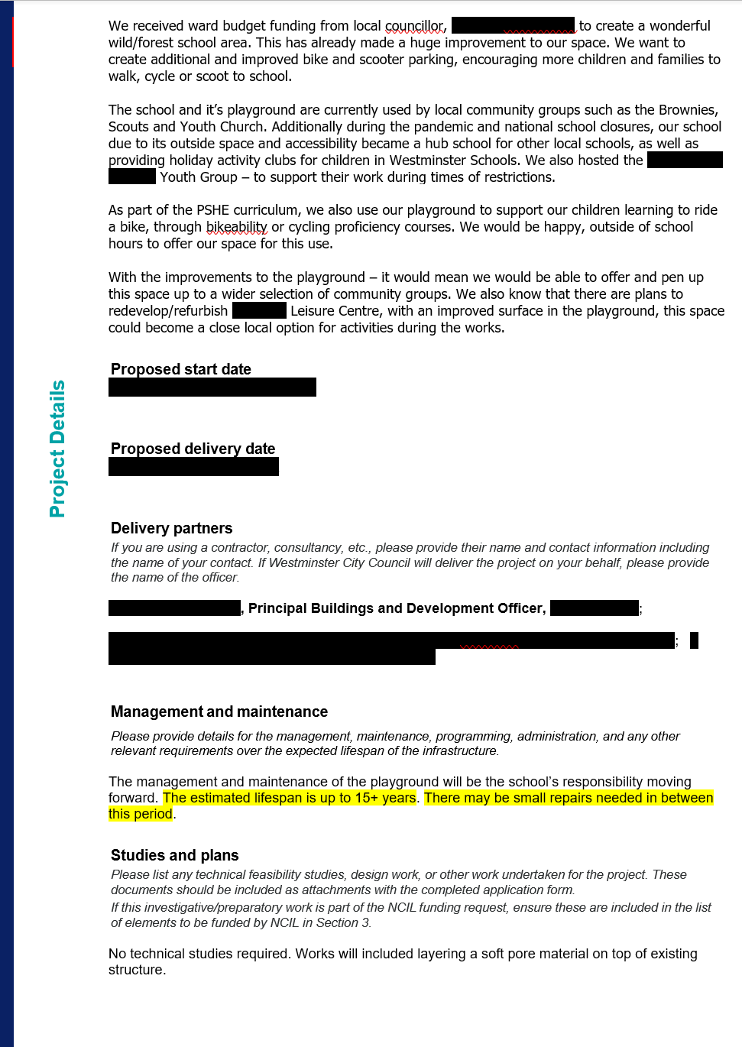
In this whole section they’ve provided relevant context, describing what the purpose of the works are and how it will benefit the wider community – clarifying to WCC how it qualifies as Community Infrastructure
Here they offered a realistic timeline – they have factored into their start date that it can take several months to receive NCIL funding. When filling out an application, you can expect that an ideal round of applications can take 3 months to decide on, and then about another month to receive the funds; however, any number of factors could cause delays
Applicant has been transparent about who else is involved in the project. This is important for us to know as it suggests things like:
the nature of your project,
how far along your plans are
the viability of the project
The extent of wider community involvement
The applicant has shown us that they’ve considered the longevity of their project. We will only offer funding to projects who can demonstrate that it is a long-term, worthwhile investment
The applicant hasn’t needed to submit any plans or studies because none were needed given the nature of the proposal

Slide 4
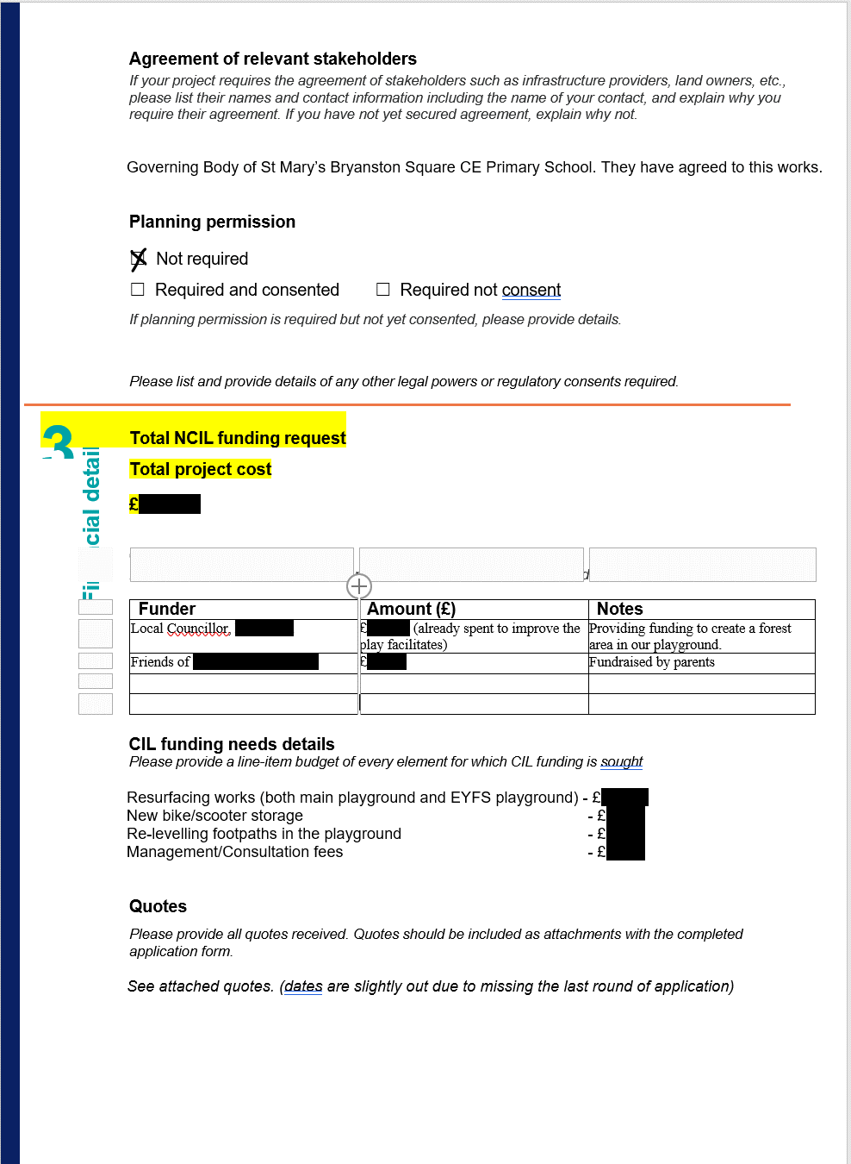
These are two separate questions:
How much is being requested from NCIL?
how much will the rest of the entire project cost?
They might be the same amount but make this clear.
This applicant has provided amounts in ‘total cost’, the table and ‘CIL funding needs details’ that don’t match. To fill this section out correctly you must:
State the entire cost of the project in the correct section
State the portion of the total cost that you are requesting to be funded from NCIL – even if it is the whole amount
Provide details of the other funders (if there are any) and the amount of funding they have committed in the table
Even if you are only requesting that NCIL pay for a portion of your project, you are required to be transparent about how you have sourced the rest of the funding and how much the whole project is expected to cost. Without this information we can’t test the proposals viability or value for money. NCIL is public funds, and we are required to be transparent about how we spend it. So, to do this, you must be too.

Slide 5
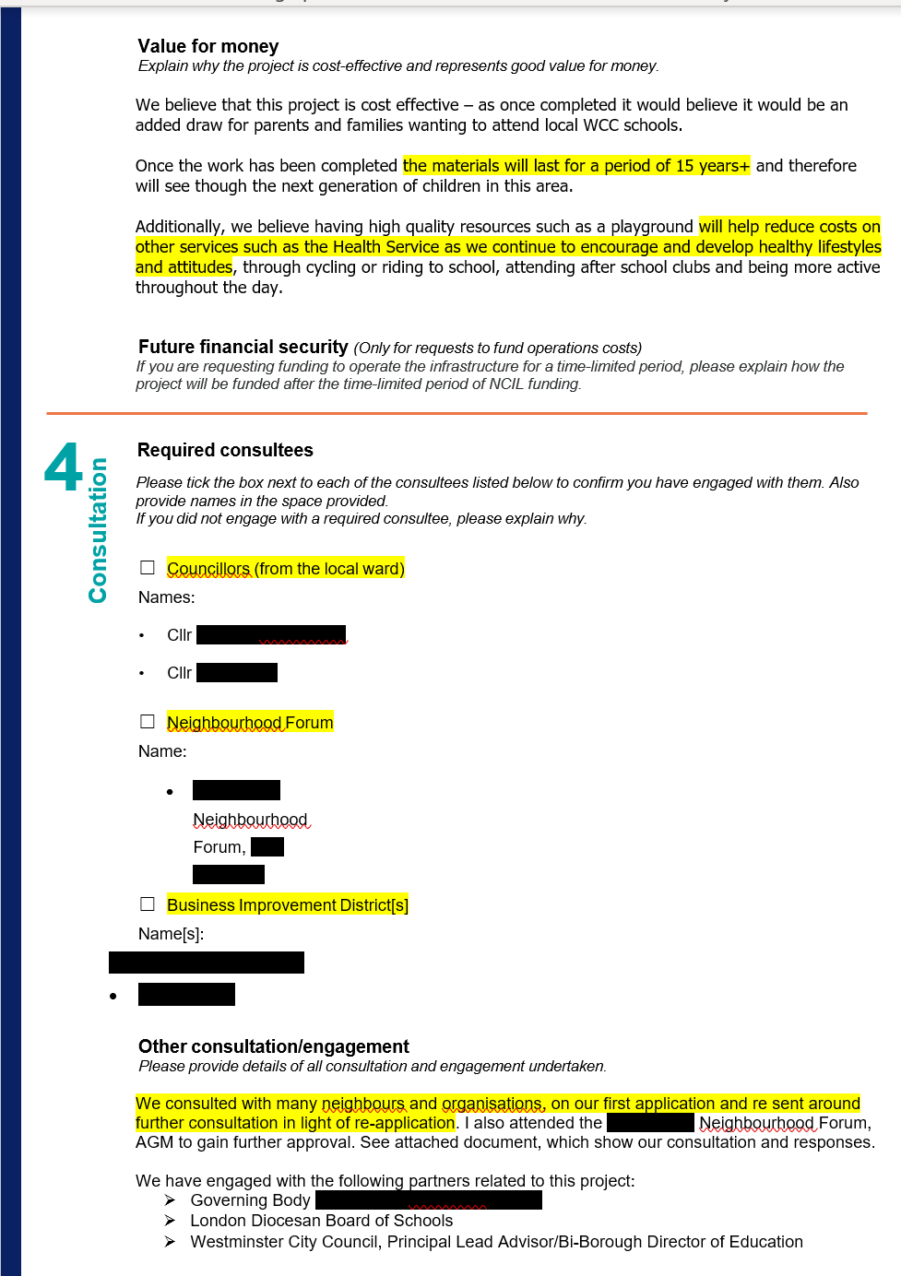
This equates to value for money, as the applicant has shown that this project will have longevity and the improvements will save money in the long term
Longer term goals: the applicant ties the project to wider Westminster initiatives and shows that they have considered the larger impacts of the development
They have identified to us and contacted all the required consultees. They’ve engaged as required to
Including all required consultees in your application means that:
We know who we must contact and don’t have to go searching for NA, NFs, BIDs and Ward Councillors
We can easily check with them that you consulted them
Doing your due diligence speeds up the application process
Providing further examples of the extent of community engagement they undertook before applying

Slide 6
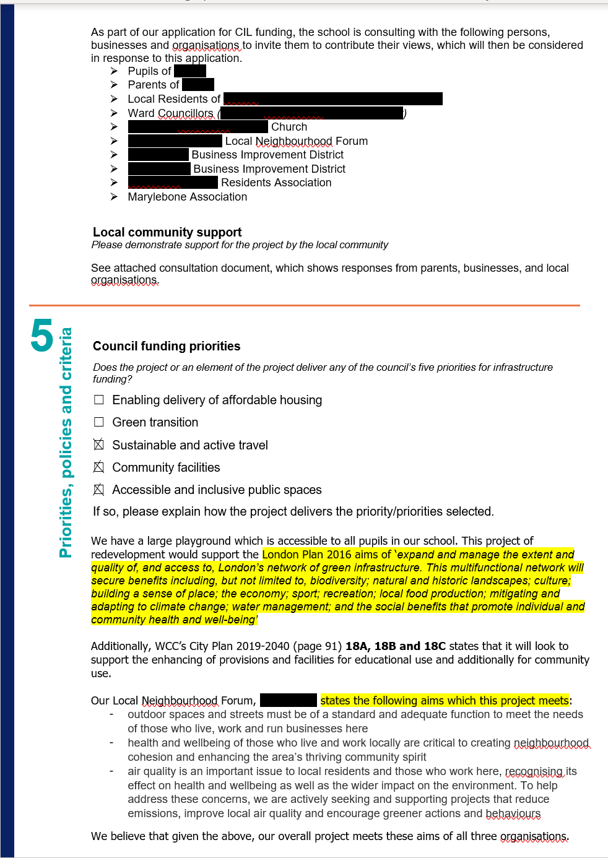
Applicant has demonstrated extensive community engagement. This is important as it shows us that there is widespread support for the projects need
The applicant has referenced a variety of planning policy that covers the area.
Referencing policies makes it easier for the council to assess your application and speeds up the time you will have a decision by
Not only has the applicant identified the priority areas, but they have also shown how it will deliver them, in relation to policies

Slide 7
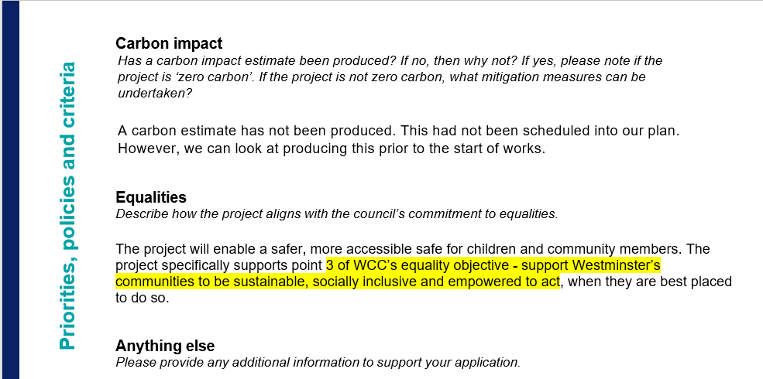
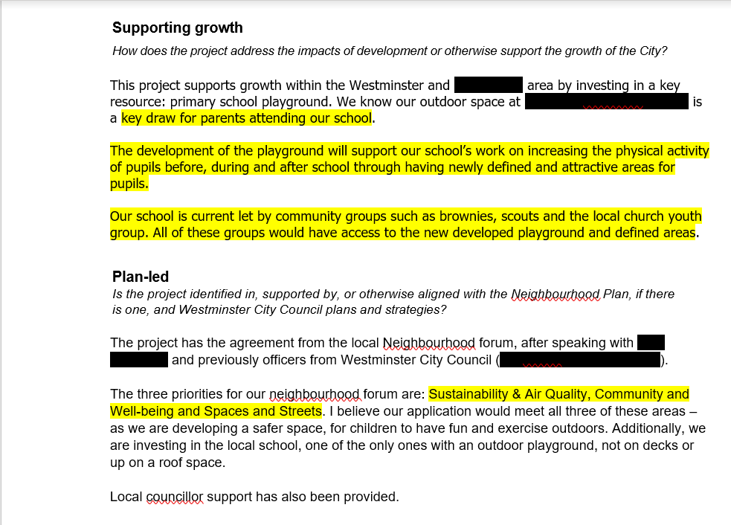
The applicant has understood Westminster’s infrastructure priorities and considered how this project helps to provide them
What would have made this application stronger would have been to state exactly how the project will mitigate or support growth:
there is a large block of flats being built and the new playground will accommodate more students (mitigation) or
The school is required be attractive to parents so that they can accommodate more pupils from the increasing population
The application has identified one of the qualifying criteria for CIL: whether the application mitigates the impact of a development, or supports the growth of the city
Demonstrates how the wider community is going to benefit from the project
This section isn’t relevant here as it doesn’t relate to ‘growth’ in relation to planning. It has also already been mentioned in the project description section
Relating the project to the aims and policies of the neighbourhood plan of the area (if there is one) is crucial to assessing the application. When an applicant identifies these areas, it makes it s lot easier for the officers to assess quickly

