Slide 1
Phoenix Green
Fire Safety Works
Bidirectionally Fire Tested / Secured by Design Flat Entrance Door-sets

Slide 2
“Dual Scope”
Fire Rated / Security
Flat Entrance Door-sets…
In all aspects of life, our safety is paramount and this is no less important when we are in the safe environment of our own homes. To ensure this is the case Phoenix Green ensure all new Flat Entrance Door-sets they install are from a range of “Dual Scope” Fire Rated Door-sets which have BI-DIRECTIONAL fire-test evidence and SBD (Secure by Design) accreditation to PAS24 2016.
This in conjunction with our “Q-Mark Fire Door Installer” accreditation ensure that the most rigorous requirements have been met in the overall installation. Q-Mark identification in the form of the relevant insert “plugs” further ensures the sign-off process of the installed door-set by an appointed independent officer is made a more standard procedure, as they can clearly identify the approved manufacturer and ensure the installation has been carried out all as per the specific test evidence.
Phoenix Green are fully appreciative of the importance of installing only Fire Door-sets that have been tested to perform beyond the minimum specified requirements and the fundamental requirement for physical bi-directional fire test evidence on all elements of the door-set and any associated fanlights & side-lights.

Slide 3
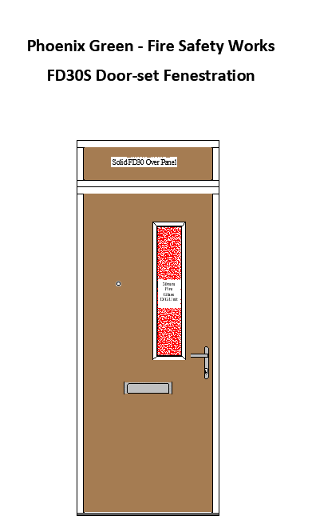
Glass Fire Rating | External Glass Pane | Internal Glass Pane
30 Minute Integrity | 6.8mm Thickness Optilam (P1A Compliant) | 7mm Pyrodur EW30 - 105
Available in Clear or Sandblasted Obscure.

Slide 4
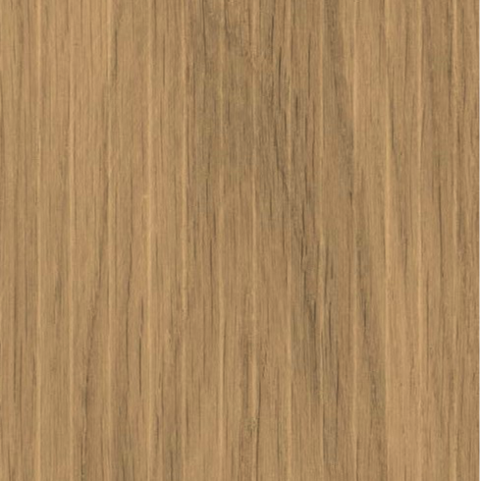
Door Colour Choices
Our Customers can select any RAL or BS Colour for their doorset finish they wish but we would advise limiting the number of choices to their clients.
RAL 7011 Steel Grey
RAL 5013 Dark Blue
RAL 9010 White
RAL 6012 Dark Green
Tenant Signature
Date
Oak Stain
Please Note
The colours shown are indicative only as printed representation and can vary from the colour as it will on your new door.
Door colour internally can be white or door colour can be same to both sides.
Frame colour to be white unless stated otherwise.

Slide 5
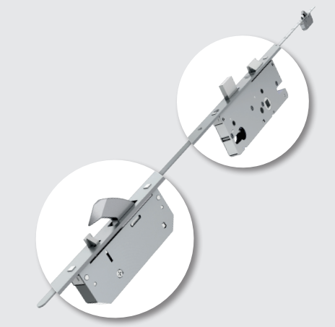
Essential Ironmongery
Locking System
Winkhaus AV2 Locking System

Slide 6
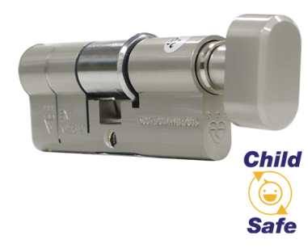
Essential Ironmongery
Thumb-turn Cylinder
3-Star Security
UAP Kinetica 3-Star Security Cylinder

Slide 7
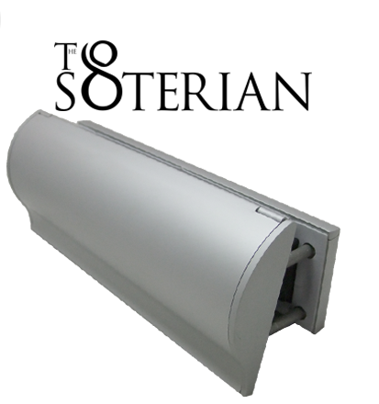
Essential Ironmongery
TS008 Fire-Rated
Letter-plate
UAP Soterian TS008 Fire-Rated
Letter-plate

Slide 8
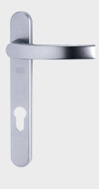
Essential Ironmongery
Lever Handles
Winkhaus 425 Lever Handles

Slide 9
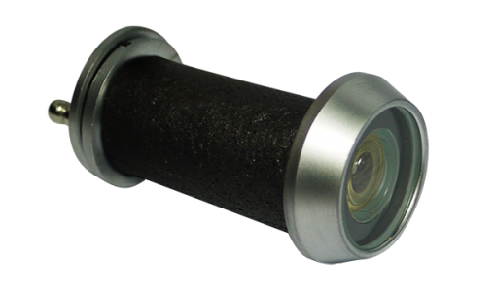
Essential Ironmongery
Door Viewer
UAP Fire-Rated Door Viewer

Slide 10
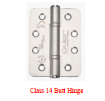
Essential Ironmongery
Door Hinges

Slide 11
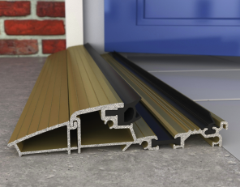
Essential Ironmongery
Aluminium Threshold
Aluminium Threshold

Slide 12
Non-essential Ironmongery Door Numerals
70mm High Brushed Aluminium Self-adhesive Door Numerals

